Slide 1
Lecturer
MatLab
Diyala university / College of Engineering
Omar A. Imran
Department of Chemical Eng.
Second Class
2019 – 2020
MATLAB For
Chemical Engineer
Trail Version
Trail Version
Trail Version
Trail Version
Trail Version
Trail Version
Trail Version
Trail Version
Trail Version
Trail Version
Trail Version
Trail Version
Trail Version
Introduction to MATLAB
MATLAB (MATrixLABoratory) is a high-level technical computing language and interactive
environment for algorithm development, data visualization, data analysis, and numerical
computation. MATLAB is one of a number of commercially available, sophisticated
mathematical computation tools, which also include Maple, Mathematica, and MathCad. The
name MATLAB stands for MATrix LABoratory, because its basic data element is a matrix
(Array). MATLAB contains a large number of functions that access proven numerical libraries,
such as LINPACK and EISPACK. In fact, MATLAB has many built-in tools for solving
problems and developing graphical illustrations. This means that many common tasks can be
accomplished with a single function call. MATLAB was originally written in FORTRAN and
later rewritten in C, a precursor of C++. The beauty of MATLAB is that we need to know only a
tiny bit to get going and be productive. Once we get started, we can pick up new skills quickly
with MATLAB’s excellent online help features. MATLAB is optimized for matrices. Thus, if a
problem can be formulated with a matrix solution, MATLAB executes substantially faster than a
similar program in a high-level language.
1. Getting Started
You can start MATLAB as you would any other software application. In Windows, you access it
via the Start menu. Alternatively, you may have a desktop icon that enables you to start
1

Slide 2
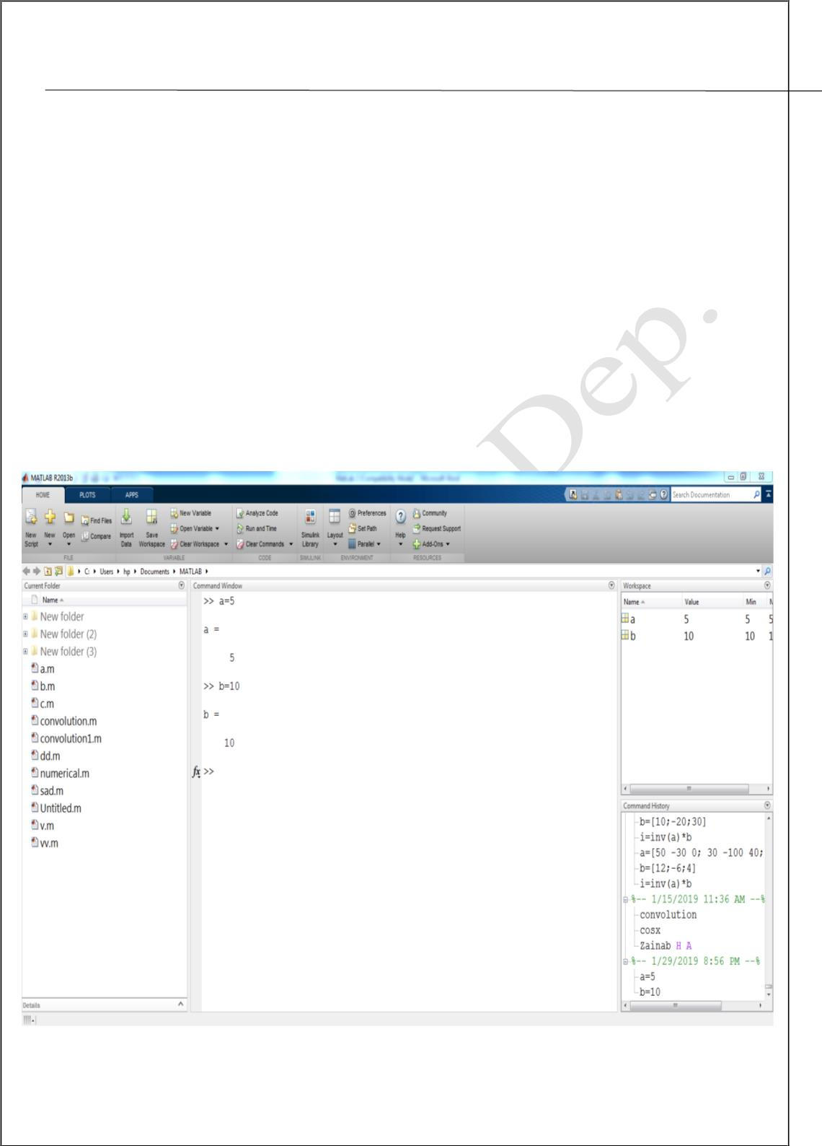
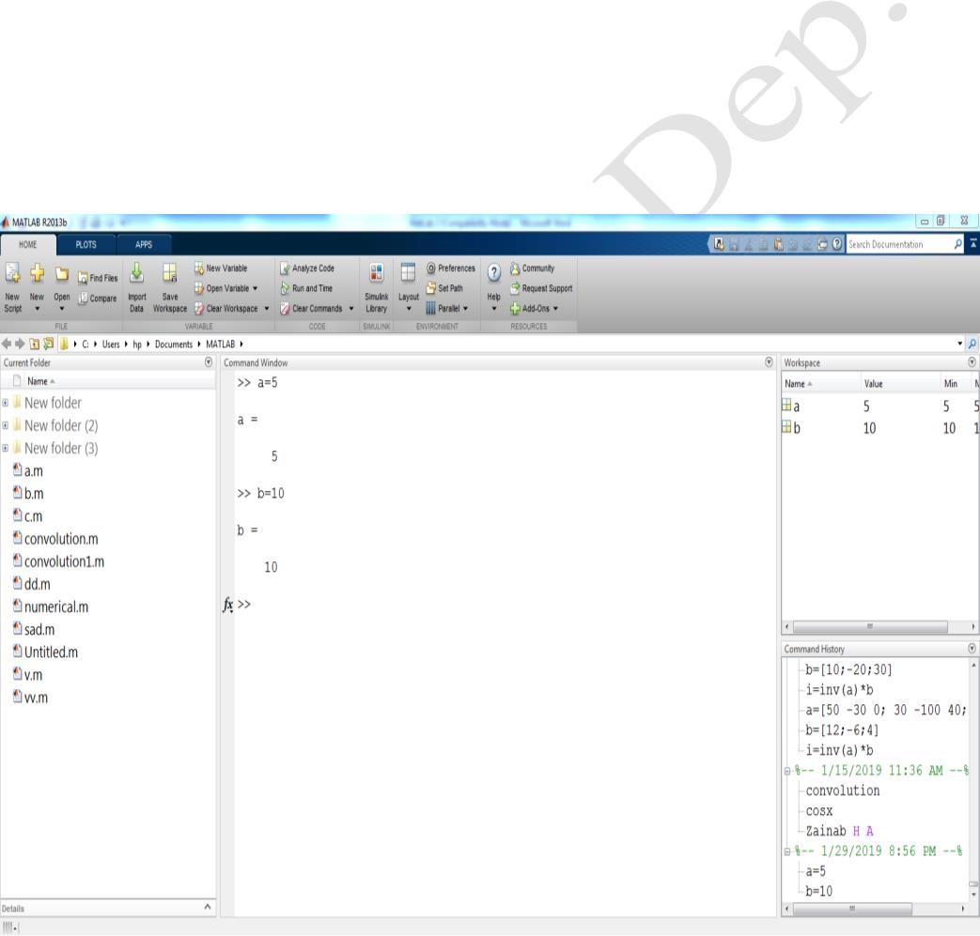
Lecturer
MatLab
Diyala university / College of Engineering
Omar A. Imran
Department of Chemical Eng.
Second Class
2019 – 2020
MATLAB with a simple double-click. When the MATLAB is started, a window opens in which
the main part is the Command Window. Figure 1 contains an example of a newly launched
MATLAB desktop. In the Command Window, you will see the prompt (>>). If the Command
Window is active, the prompt will be followed by a cursor. That is the place where you will
enter MATLAB commands. If the Command Window is not active, just click in it anywhere. In
addition to the Command Window, there are a couple of other windows that may be opened by
default. The layout can always be customized. To the left of the Command Window is the
Current Folder Window. The folder that is set as the Current Folder Window is where files will
be saved. This window shows the files that are stored in the Current Folder. To the right of the
Command Window are the Workspace Window on top and the Command History Window on
the bottom. The Command History Window shows commands that have been entered. The
configuration of each window can be altered by clicking the down arrow at the top right corner
of the window. This will show a menu of options including closing and undocking that window.
Alternatively, hitting the down arrow under Layout in the “HOME” tab allows for the
customization of the window within the desktop environment as shown in Figure 2.
Trail Version
Trail Version
Trail Version
Trail Version
Trail Version
Trail Version
Trail Version
Trail Version
Trail Version
Trail Version
Trail Version
Trail Version
Trail Version
Figure 1. MatLab Window
2

Slide 3
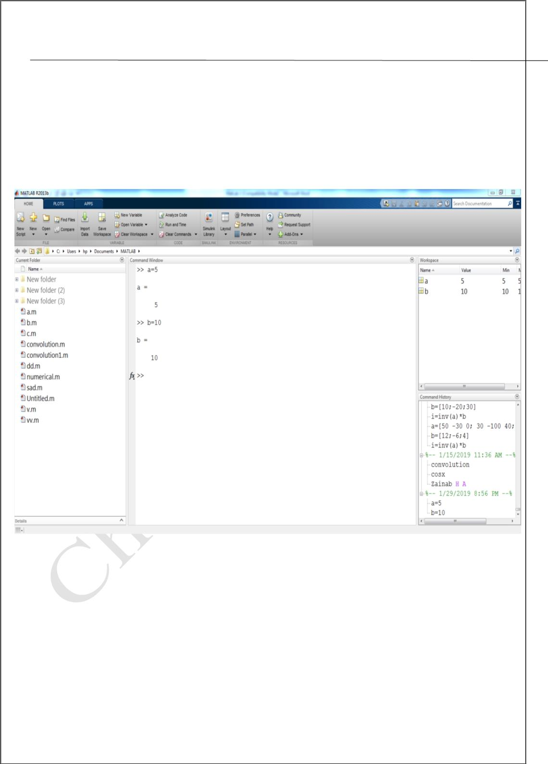
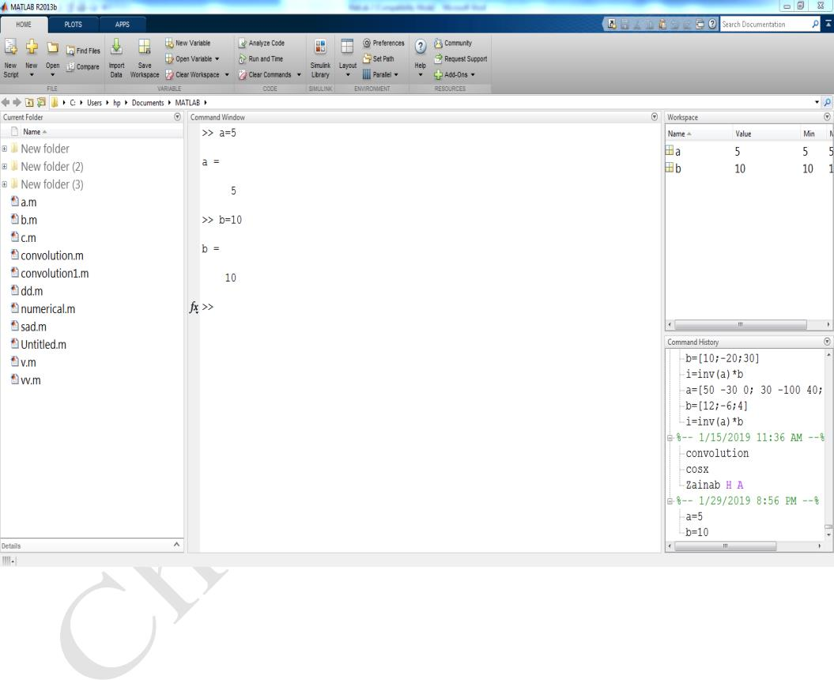
Lecturer
MatLab
Diyala university / College of Engineering
Omar A. Imran
Department of Chemical Eng.
Second Class
2019 – 2020
1.1 Alternate windows:
The smaller of the two windows is alternate windows that can be accessed by
clicking on the tabs. Figure 2 shows the alternate windows and describes their
functions.
Trail Version
Trail Version
Trail Version
Trail Version
Trail Version
Trail Version
Trail Version
Trail Version
Trail Version
Trail Version
Trail Version
Trail Version
Trail Version
Figure 2. Alternate windows
1.2 The command window:
The command window is the active window immediately appears after launching
Matlab. One enters Matlab commands after the ">>" prompt and presses enter to
execute the command. To recall the last commands entered, simply press the up or
down arrows; one can edit the commands before executing them. Multiple
3

Slide 4
Lecturer
MatLab
Diyala university / College of Engineering
Omar A. Imran
Department of Chemical Eng.
Second Class
2019 – 2020
commands may be entered on one line separated by commas. Separating
commands by a semi-colon suppresses output to the command window.
This window allows a user to enter simple commands. To perform a simple
computations type a command and next press the Enter or Return key. For instance
>> s = 1 + 2
s =
3
Note that the results of these computations are saved in variables whose names are
chosen by the user. If you need to obtain their values again, type their names and
pressing Enter key. If you type again:
>>s
s =
3
Trail Version
Trail Version
Trail Version
Trail Version
Trail Version
Trail Version
Trail Version
Trail Version
Trail Version
Trail Version
Trail Version
Trail Version
Trail Version
Only for short computations it is useful to execute Matlab straightaway from the
command line. The Editor Window is a word processor specifically designed for
MATLAB commands. Files that written in this window are called the m-files.
Another way to do calculations in MATLAB is to create an m-file with a series of
commands and then to run some or all of the commands in that file. To create an
m-file, click file, new and then m-files. The same statements that are entered in the
command window can also be used in an m file. You can also copy a command
you try out in the command window into an m file by using the copy and paste
functions on the computer. Save the file under a name that ends in .m by clicking
file and using “save as” icon. (See Figure 3)
4

Slide 5
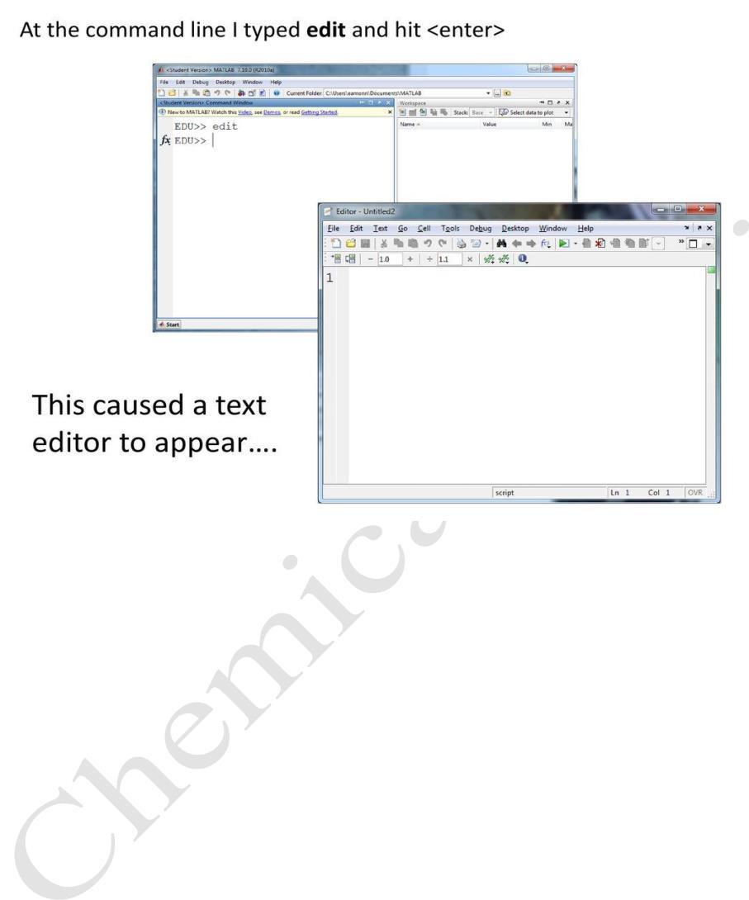
Lecturer
MatLab
Diyala university / College of Engineering
Omar A. Imran
Department of Chemical Eng.
Second Class
2019 – 2020
Trail Version
Trail Version
Trail Version
Trail Version
Trail Version
Trail Version
Trail Version
Trail Version
Trail Version
Trail Version
Trail Version
Trail Version
Trail Version
1.3 Function Files
Function files are a special kind of script file (M-file) that allow you to define your
Own functions for use during a Matlab session. You might think of them as
subroutines that can be called from within a script, or even called directly from the
command line. Many of the "built-in" functions in Matlab are actually stored as
M-files as part of the Matlab package. Function files are created and edited in
identically the same manner as the script files.
2. Numbers, Arithmetic Operations and Special Characters
There are three kinds of numbers used in MATLAB:
• integers
• real numbers
• complex numbers
5

